Slide 1

Ventilator Modes in the O.R.
USM Clinical Prep Week
2022

Slide 2
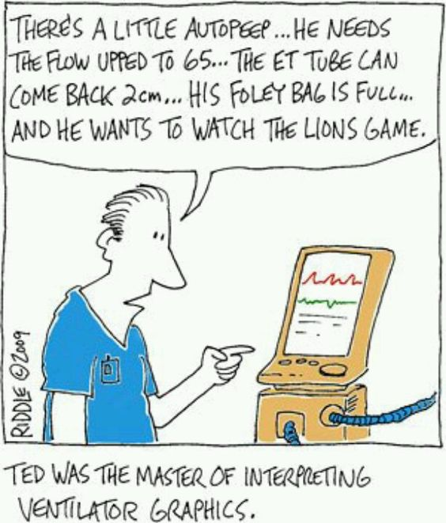

Slide 3
You can learn a lot by how your patient responds
to your ventilator settings!

Slide 4
Maintain EtCO2 32-37. (exception Neuro cases where EtCO2 is desired
<27.)
Maintain Peak Airway Pressure <30 cm H2O
Goals for Adequate Ventilation
Decrease potential for Atelectasis
SaO2 > 97%

Slide 5
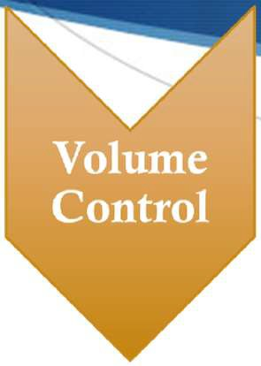


Anesthesia Machine Ventilator Modes
Selected Specific Volume
Rate Selected
Independent of patient effort or response
Selected Pressure
Variable Volume
Rate Selected
Spontaneous Breaths allowed
Preset Rate will be delivered regardless of patient effort
Preset Pressure
Notes:
SIMV = Synchronized Intermittent Mandatory Ventilation

Slide 6
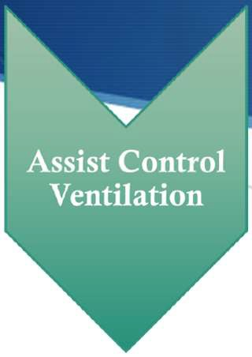
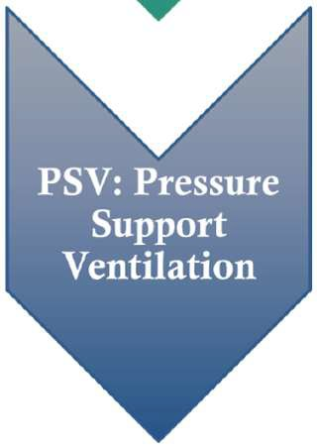
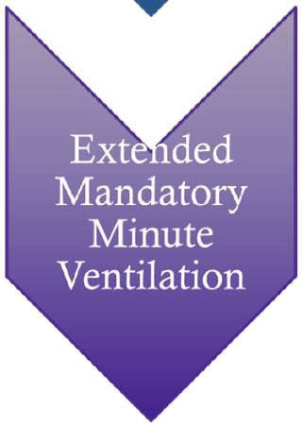
Anesthesia Ventilator Modes (cont.)
Intermittent positive pressure
Pt initiates ventilator to deliver a pre-determined tidal volume.
Back-up mode should patient be unable to initiate a breath
Preset level of positive airway pressure
Patient determines ventilatory rate
Designed to increase the volume of the patients spontaneous breath
Decreases overall work of breathing especially diaphragmatic fatigue
Preset Minute volume of gas either from a positive pressure breath or a spontaneous breath
Preset mechanical rate and volume
The goal is have patients use more of their respiratory muscles

Slide 7
Adjunct Ventilator Settings
I:E
Ratio of Inspiration to Expiration
Time Inspired (PCV)
Positive airway pressure when using I:E to increase inspiratory time
Expiratory time to allow adequate CO2 removal in COPD patient
Inverse Ratio Ventilation
PEEP
Positive Pressure designed to keep alveoli open throughout the respiratory cycle.
Intrinsic vs. Extrinsic
Notes:
Check twitches and PIP

Slide 8
Volume Controlled Ventilation
VCV
Preset Tidal Volume
Preset Respiratory Rate
Patient is unable to generate any respiratory effort
Paralysis
Pre-existing Physical condition
Highest Mean Airway Pressure of the different Ventilator modes
Ideal for the healthy patient without compliance or resistance issue

Slide 9
Pressure Controlled Ventilation
PCV
Volume is determined by preset pressure
Time Triggered ventilatory cycle
Ability to be delivered in IMV(intermittent mandatory) or ACV (assist control) modes
Has a Decelerating Flow Pattern which improves distribution of gases
Ideal for patient with decreased compliance due to
Body habitus
Pt position
Surgical Case
Must set the Maximum Tidal Volume, especially during laparoscopic cases
Notes:
The flow rises quickly to a maximal value and then decreases progressively throughout the breath

Slide 10

Ventilator
PEARL
Pressure Control Ventilation with Volume Guarantee (PCV- VG)
Volume and Pressure are preset
Preset Volume with a Max PAP!
Ventilator adjusts PIP to achieve preset TV breath by breath
Key Advantages:
Controlled Peak Inspiratory Pressure
Control of Minute Ventilation
Preset Volume delivered each breath at the minimum necessary pressure

Slide 11
SIMV
Synchronized Intermittent Mandatory Ventilation
Combination of Assist-Control Ventilation and Spontaneous Ventilation
Baseline Respiratory Rate that allows patient to breath at their own rate in between ventilator initiated breaths
Preset Inspiratory pressure for intermittent mandatory breaths
Ventilator attempts to synchronize mandatory breaths with patient-initiated breaths.
PSV (pressure support ventilation) is used in conjunction with SIMV
Pt sets own respiratory rate with minimum pressure applied for each breath

Slide 12
Assist Controlled Ventilation
Intermittent positive-pressure ventilation mode in which the patient creates a sub-baseline pressure in the inspiratory limb which then triggers the ventilator to deliver a predetermined tidal volume.
Back-up control mode should respiratory rate drop below a preset level.
Every breath is same volume whether patient initiates or the ventilator delivers
Not for patients with a rapid respiratory rate

Slide 13
What does the Research Say
S Gajic, et. al: Patients ventilated with TV >12% IBW were 25% more likely to have ALI or ARDS
S Choi et al.: Study noted that patients that were ventilated with 12 ml/kg at 5 hours showed significant procoagulant changes indicative of Acute Lung Injury when compared to Lung Volumes of 6ml/kg with 10cm PEEP.
S Research done by the International Anesthesia Research Society shows PEEP increases intrathoracic pressure and the effects are amplified in patients suffering hypovolemia or cardiac dysfunction.

Slide 14
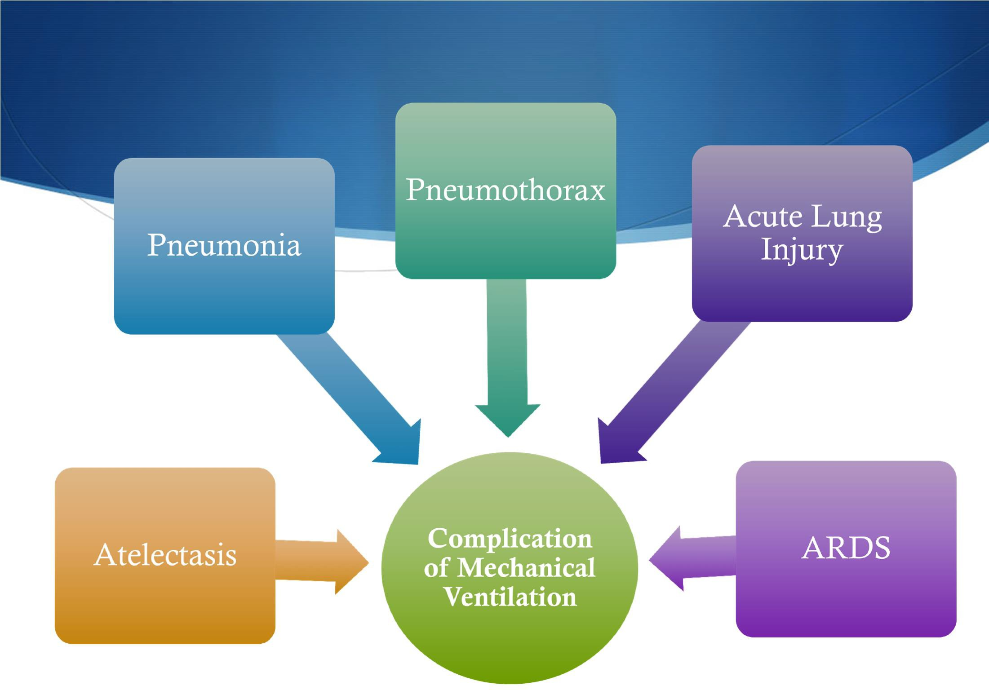
Notes:
AAAPP

Slide 15
Keys to overcoming Ventilatory Complications
Pre-oxygenation
⬇ Hypoxia
⬆ FRC
⬇ Reabsorption Atelectasis
Obesity
⬇ FRC
37% of closed claims related to difficult intubation involved obese patients.
Intermittent Alveolar Recruitment Breaths or SIGHs
Essential that pre-oxygenation with a Facemask is practiced.

Slide 16
Pre-Existing Conditions that Compromise Ventilation
COPD
Emphysema
Asthma
Chronic Bronchitis
OSA
Tracheal Stenosis
Previous Lung Resection
ARDS

Slide 17
The dark side of mechanical ventilation
S Hypotension
S Increased Intrathoracic Pressure causing Decreased Venous Return
S Positive Pressure Ventilation
S Potentiated w/Insufflation for Laparoscopic Procedures
S ⬇Cardiac Output
S Airway
S Tracheal Scarring as a result of intubation
S Negative Pressure Pulmonary Edema
S Vocal Cord Damage
Notes:
20 cm H2O in the cuff

Slide 18
Case Study #1
43 y/o F for Robotic Vaginal Hysterectomy w/BSO secondary to Tumor.
PMHx:
BMI 48.2
Obstructive Sleep Apnea (CPAP at home)
HTN
NIDDM
Position: Steep Trendelenburg
Anesthesia: General Anesthesia
Paralyzed
ETT
Ventilation: WHAT WOULD YOU DO? What are your starting settings?
TV? I:E ratio? Rate? Mode?

Slide 19
Case Study #2
S 38 y/o M for Laprascopic Robotic Gastric Bypass
S BMI 58.2
S PMHx:
S HTN
S NIDDM
S OSA
S Gout
S PSHx:
S Appy
S Cholecystectomy
S Shoulder Athroscopy
S What is your Anesthesia and Ventilation Plan?

Slide 20
Case Study #2 (cont.)
S Position: Reverse Trendelenburg
S Endoscopy performed(? Surgeon Dependent)
S Induction:
S Lidocaine
S Propofol
S Succinylcholine
S Remi-Fentanyl
S (.75mcg/kg/min followed with a maintenance of
.2mcg/kg/min)
S Dilaudid
S 1mg at the end of the procedure
S ERAS Protocol if surgeons are on board.
S Minimal Post-op Pain secondary to local anesthetic How are you going to ventilate this patient?

Slide 21
Optimizing Ventilation
S Tidal Volume (6 – 8ml/kg) although lower volumes are ideal
S PEEP 3-5 cm H2O
S Respiratory Rate
S Maintain pCO2 32-37 (homeostatic state)
S Peak Airway Pressure < 30cm H2O
S ARDS
S Utilize I:E Ratio
S Intermittent Recruitment Breaths
S Manually Insufflate to a PAP 40-50.
S Every 5 - 30min.
Must be able to adapt for DECREASED Compliance and INCREASED Resistance

Slide 22
Spontaneous Ventilation
S Optimization of the spontaneously breathing patient.
S Respiratory Rate driven by patient
S Should patient not breath for a preset time (30sec) SIMV mode ventilation OR hand bagging is initiated.
S Pressure supported breath to achieve adequate TV for each patient initiated breath may be used during wake up OR manual bag ventilation may be used as well.
S Research shows SV is a superior mode to SIMV when weaning a patient from mechanical ventilation, sources differ.

Slide 23
Summary
S Mechanical Ventilation is a standard of care in General Anesthesia
S Selection of Ventilation mode should be determined by
S Surgical Case
S Patient position
S Pre-existing respiratory disease and function
S Patient BMI
S Prevent atelectasis by using low TV and low PEEP.
S Do not be afraid to use different ventilator modes and I:E Ratio to maximize ventilation.

